Slide 1

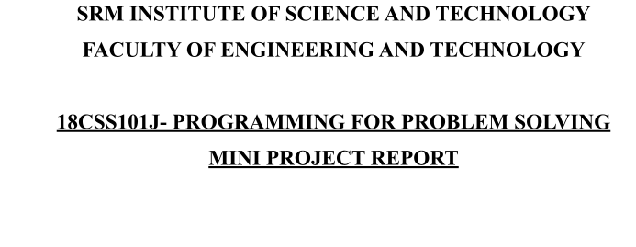
PROJECT TITLe
Submitted by:
Name & Reg. No : Amogh Kuppachi (RA2111003011866)
Branch: CSE (CORE) Section: Z2
Table of contents

Slide 2
Title
Page Number
1) Description…………………………………….…….…….3
2) Features……………………………………………………3
3) Problem Statement………………………………………...4
4) Objective……………………………..………….…………4
5) Algorithm………………………………………..….……..6
6) Output……………………………………………………..9
7) Conclusion………………………………………………..,

Slide 3
DESCRIPTION:
Movie Ticket Booking System is based on the concept of booking movie tickets. There’s no login system available for this system, the user can freely use its feature.
the user can book movie tickets. For this, the user has to select a movie name, enter customer details such as name and phone number. Then the user has to enter seat number. After this, the booking is done. The user can also change the ticket price and view reservations by entering the admin password. The last feature of this project is about canceling the tickets which can be done by entering the booking id.
The system does not create an external file to store the user’s data permanently. This system is in C Programming Language and different variables, strings have been used for the development of it.
FEATURES:
Booking tickets
Cancel tickets

Slide 4
Change ticket price
View all booking records
PROBLEM STATEMENT:
To create a platform for public to book tickets for movie of any application and by using internet
OBJECTIVES:
i. To provide another way for the customer to buy cinema ticket, get the information about movies.
ii. To provide the customer the complete information of the movie, according to which the customer can view all the movies, book the tickets and the view all

Slide 5
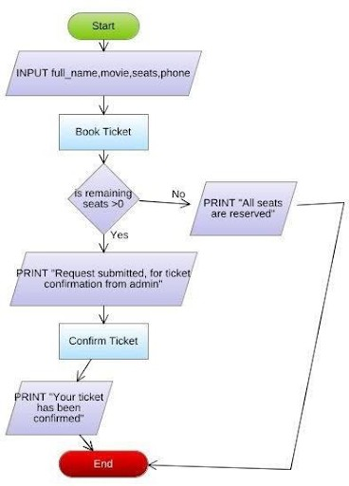
transactions facility system.
provides more flexibility to the
CONTROL FLOW DIAGRAM:

Slide 6
ALGORITHM:
START
CHOOSE from :I> Book Ticket ii>To View Now playing Movies iii>To Add New Movies
iv>To Delete Now playing Movies v>To View All Transaction
vi>To Delete All Transaction vii>Exit
If you choose above choice then program move forward else display you choose wrong choice
IF CHOOSE==1 THEN
Call Book Ticket Function
OPEN movies name, relase date, price per seat(row) iii.THEN ask to user book ticket or not in terms of (y/n) If user say==’y’
Then ask to user user name ,mobile number, which seat wants and how many seat wants after all this generated bill
Else exit
END.
IF CHOOSE==2
CALL view playing movies
Open all the playing movies 6.IF CHOOSE==3
CALL Add New movies(Only Admin)
Login for Admin If(Password==Correct)
Then move forward
Admin add this information movies name, release date,price row wise Else
Exit iii.END
IF CHOOSE==4
CALL Delete playing movies(Only Admin)
Login for Admin If(Password==Correct)
a. Then move forward

Slide 7
b. Admin can delete information Else
Exit
Iii .END
IF CHOOSE==5 THEN
CALL View All the transaction(Only Admin)
Login for Admin If(Password==Correct)
Then move forward
Admin can see the transaction information Else
Exit iii.END
IF CHOOSE==6 THEN
CALL Delete All the transaction(Only Admin)
Login for Admin If(Password==Correct)
Then move forward
Admin can DELETE the transaction information Else
Exit iii.END 10.END

Slide 8
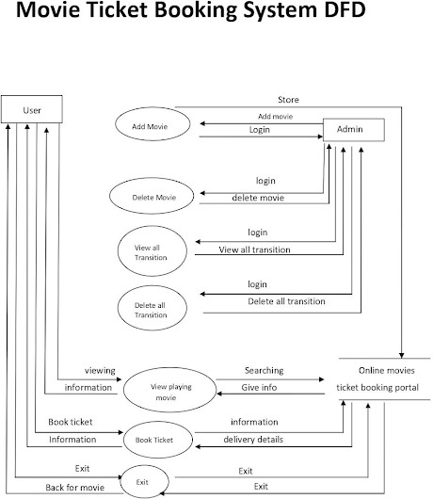

Slide 9
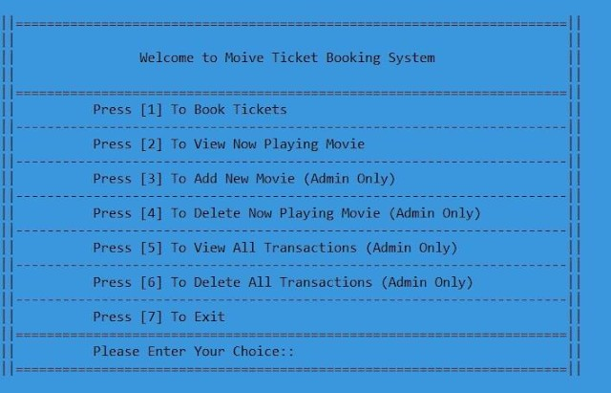
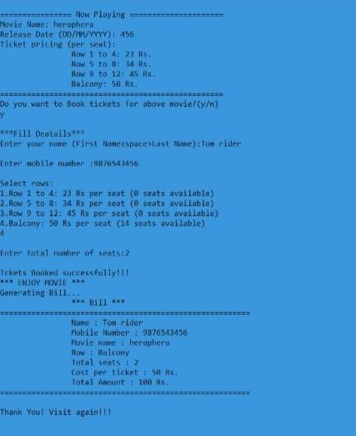
OUTPUT SCREENSHOT :
MAIN MENU:
BOOKTICKET:

Slide 10
CONCLUSION:
Nowadays, traditional reservation ways of cinema ticketing is dying.its new age where technology dominates human life.with the software and technological devices,exceptions are reduced and even terminated. Also, people prefer easy, quick and safe way for every part of his/her life. this project is designed to meet the requirements of movie ticket booking system.

